Slide 1


[Report]

Slide 2


Today's agenda
Project recap
Problem
The Analytics team
Process
Insights
Summary

Slide 3


Social Buzz is fast growing technology unicorn
That need to adapt quickly to it’s global state.
Accenture has begun a 3 months POC focusing on these tasks:
An audit of their big data practice.
Recommendations for a successful IPO .
An analysis of their content categories that highlights the top 5 categories with the largest aggregate popularity .
Project Recap

Slide 4


Problem
Over 100000 posts per day
36,500,000 pieces of contents per year!!!
But how to capitalize on it when there is so much ?
Analysis to find Social Buzz’s Top 5 most popular categories of content

Slide 5



My self
Data Analyst
The Analytics team
Marcus Rompton
Senior Principle
Andrew Fleming
Chief Technical Architect

Slide 6

Process
1
Data Understanding
2
Data Cleaning
3
Data Modelling
4
Data Analysis
5
Uncover Insights

Slide 7
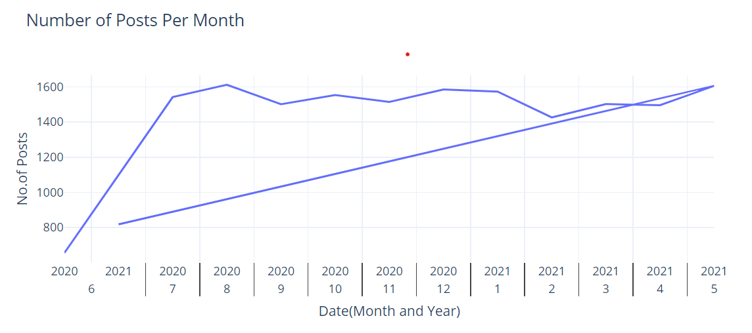
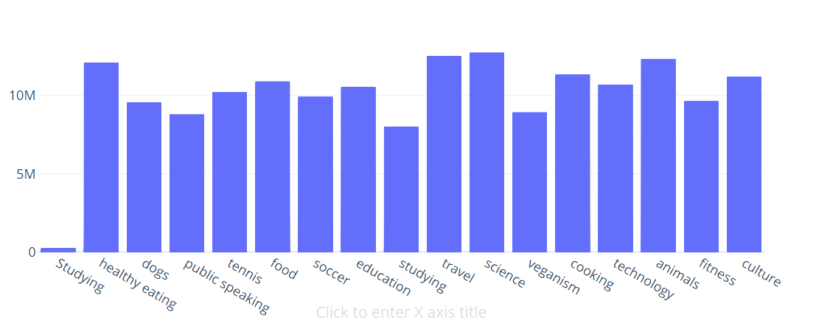
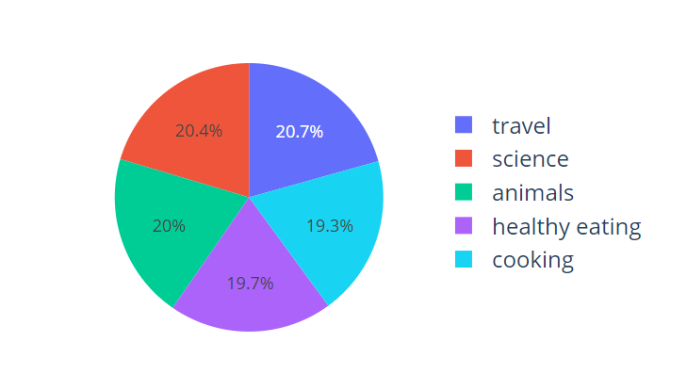


Insights
Categories
Top Categories
No.of Posts Per Month

Slide 8
How many unique categories are there?
Our analysis revealed that the dataset contains 17 unique content categories. These categories encompass a diverse range of topics, showcasing the variety of content that Social Buzz users engage with. Understanding the breadth of these categories helps us pinpoint key areas where content is being generated and consumed, allowing the company to strategically focus on the categories that resonate most with their audience.
How many reactions are there to the most popular category?
He 5 most popular category are Travel, Science, Animal, Healthy Eating and Coking, which will be identified based on the aggregate reaction scores, stands out as the one that has garnered the most user engagement. This category, having the highest total number of reactions, suggests a strong user preference and interaction. By examining the sentiment and type of reactions within this category, Social Buzz can capitalize on this content to boost engagement even further.

Slide 9
What was the month with the most posts?
Our data analysis also highlights August 8th August 2020 as the highest volume of posts, with 1,612 total entries. This spike in activity provides valuable insights into seasonal trends and user behaviour. Identifying the reasons behind this surge—whether driven by specific events or organic user engagement—can help Social Buzz strategize for future content planning and optimize user interactions during high-traffic periods.

Slide 10


The dataset contains 17 unique content categories, reflecting the diverse range of content Social Buzz users engage with.
Summary
The top 5 categories—Travel, Science, Animals, Healthy Eating, and Cooking—have garnered the highest user engagement based on reactions.
August 2020 had the most posts, with 1,612 entries, marking a significant spike in user activity.

Slide 11

Thank you!
ANY QUESTIONS?

